Slide 1
Grids and Portals for VLAB
Marlon Pierce
Community Grids Lab
Indiana University

Slide 2
Introduction
This will be a very high level talk.
Half-day tutorial material on Grids and portals is available from here:
http://www.servogrid.org/slide/iSERVO/VLABJuly21-23/VLAB-Portal-Grid-Slides/
Tutorial includes
Grid portal standards and development
Grid overview
Security review
Globus tools for data and job management
Condor

Slide 3
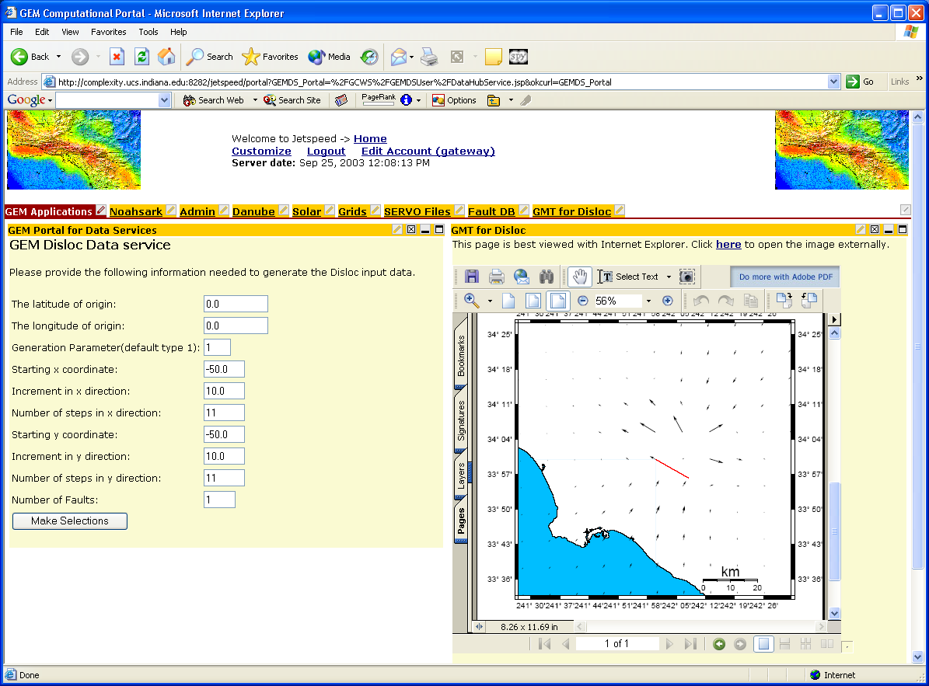
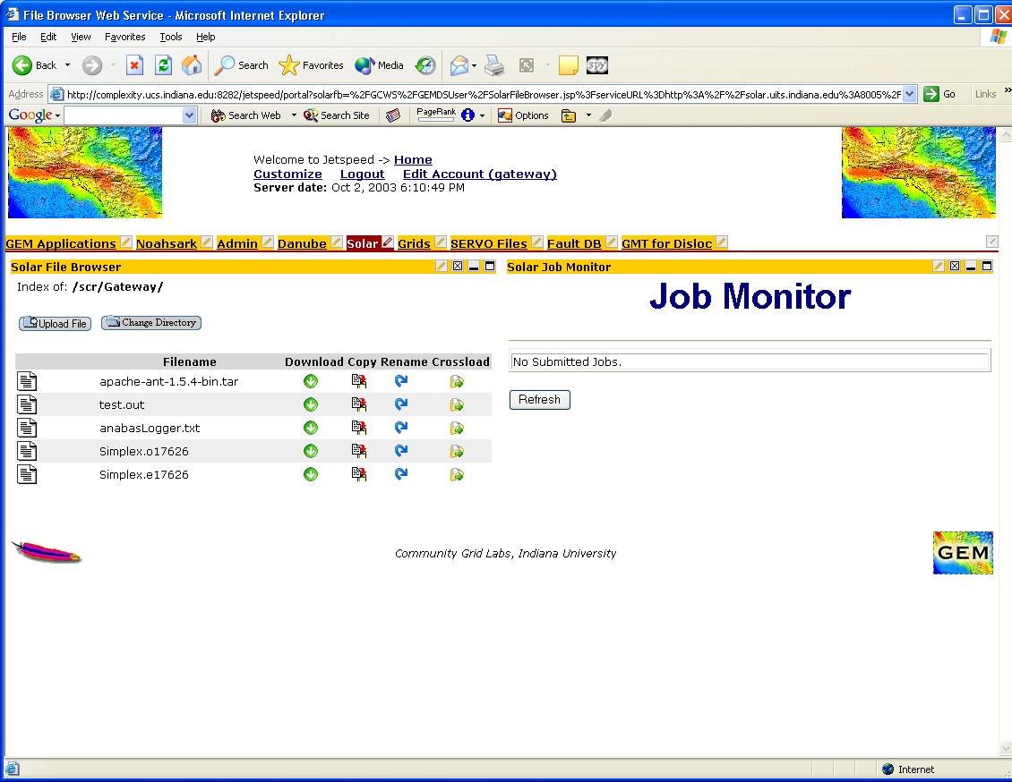
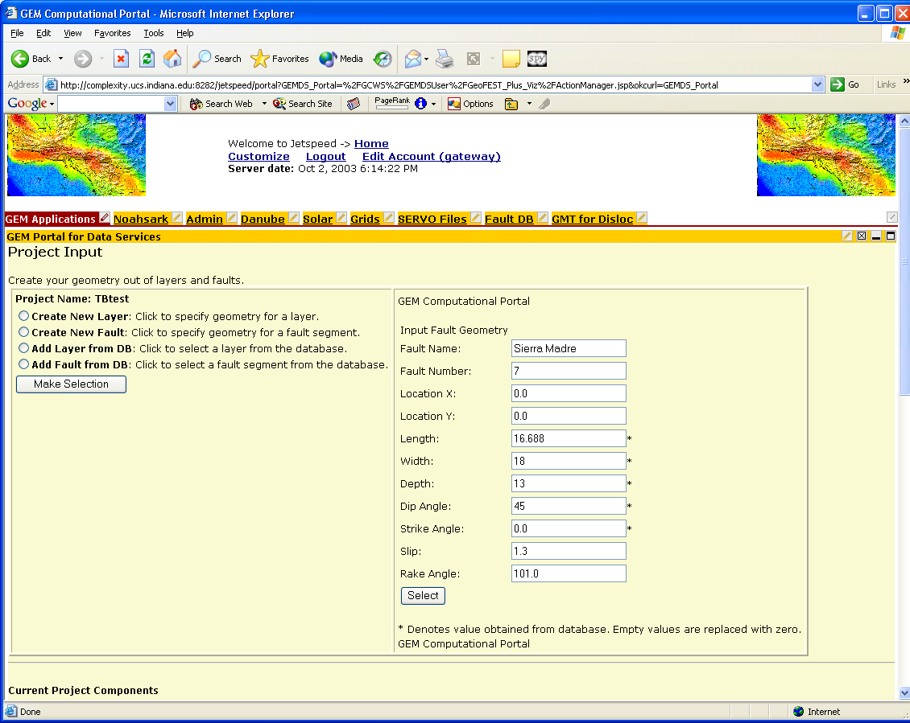
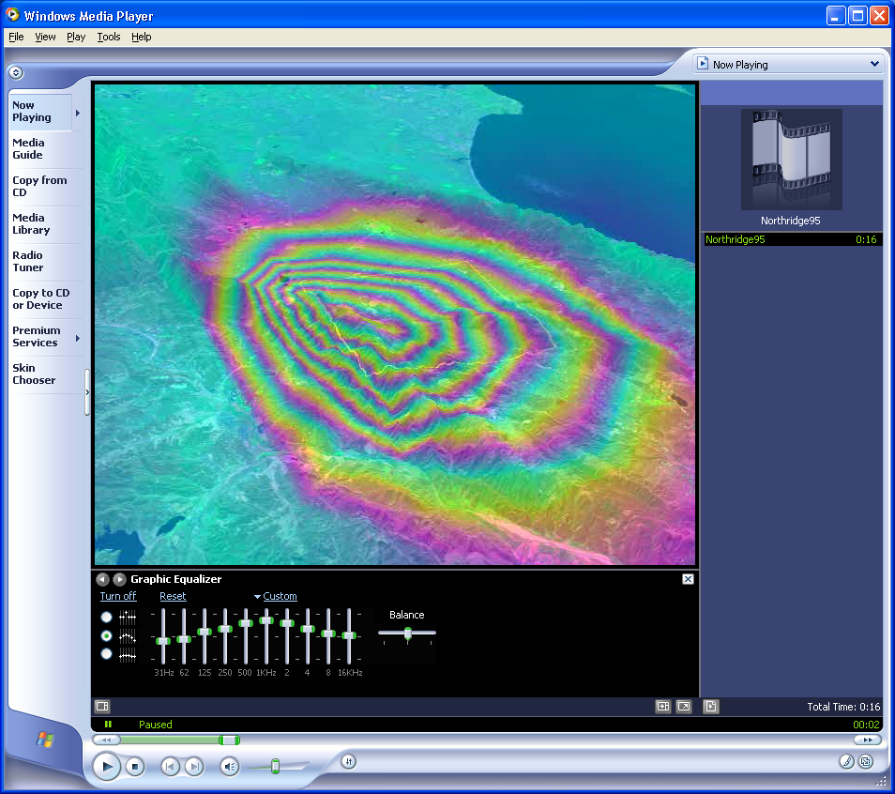
QuakeSim Portal Shots

Slide 4
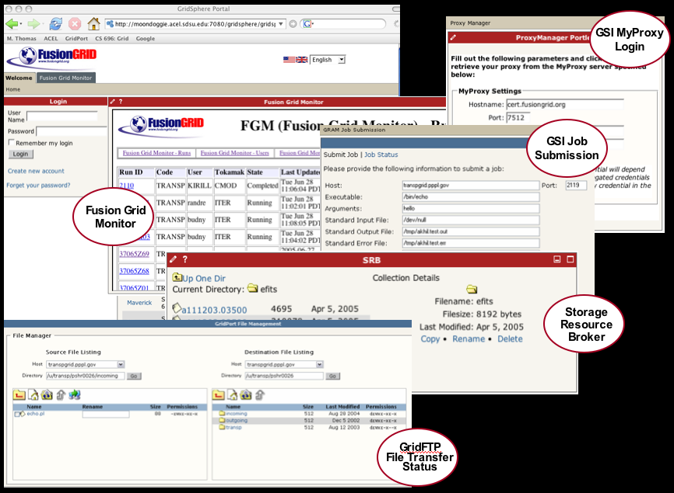

Slide 5
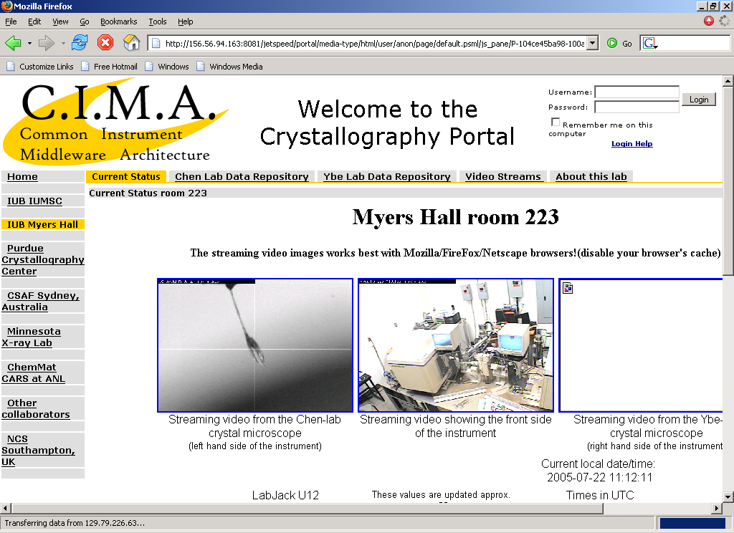

Slide 6
Three-Tiered Architecture
Grid and
Web
Protocols
JDBC,
Local, or
Remote
Connection
Portal User Interface
Portal
Client
Stub
Database
Service
Database
Portal
Client
Stub
Grid Resource
Broker Service
HPC
or
Compute Cluster
Portal
Client
Stub
Information
and
Data Services
Grid Information
Services, SRB
Three-tiered architecture is accepted standard for accessing Grid and other services
Notes:
This three-tiered architecture is depicted above. The figure greatly simplifies most portal systems described in [33] but serves as a conceptual illustration. The portal interface consists of Web interfaces that work with remote services through the service tier. The portal (presentation) layer not only must manage user information but also maintains “client stubs” that interact with a usually remote service tier. In the figure, the top-most horizontal thread illustrates a typical three-tiered scenario from e-business, in which the portal contacts the remote database through a client-server system. The server in turn contacts the database. The middle thread indicates a second user portal scenario in which a “portal client stub” accesses a Grid service through a standard Grid protocol. This service (such as a resource broker accessed through GRAM) in turn spawns a job on a High Performance Computer (HPC) system. The final thread illustrates portal access to Grid specific data and information services such as the Storage Resource Broker (SRB) [44] [45].
This architecture has been widely adopted, and from this we conclude that computing portal architectures are well established, with a range of standard services for accessing the Grid through such systems as the Java [46] and Perl [47] CoG kits.

Slide 7
What Is a Grid Good For?
Hiding network programming details.
Providing useful services for accessing remote resources.
Running codes on remote machines, moving files around, monitoring remote machine usage, etc.
Secure access to remote computers, data storage.
Cross-institutional distributed computing.
UMinn + FSU + LSU + IU + European Partners+…

Slide 8
Some Common Grid Software
Globus Toolkit
Web Services and UNIX daemons for secure remote execution, file transfer, monitoring, notification, …
Condor
A popular super-scheduler for submitting jobs on idle resources.
Condor and Globus are packaged together in the NMI releases from the Grids Center.
http://www.grids-center.org/
Data and Metadata Management Tools: Storage Resource Broker, etc.
Others will discuss

Slide 9
A Simple Picture
UMinn
Resource
“Run Job”
“Move File”
My
Desktop
Computer
FSU
Resource
LSU
Resource
My Security Ticket

Slide 10
Building Grid Applications
If you download Globus, you get a bunch of command-line tools
“grid-proxy-init’,“globus-url-copy”, “uberftp”, “globus-run”, etc.
There are also application programming interfaces.
The Java CoG Kit
Python CoG Kit
Allows you to build java or python applications that include Globus and Condor calls.

Slide 11
Portlet Components for Portals
Portlets are reusable components that can be shared between developers.
Portlets run in “portlet engines”
Jetspeed, uPortal, GridSphere
Portlets are single Java components for creating HTML displays and making connections to remote resources.
Can contain applets, java web start applications, etc.
Portlet Containers are responsible for
Login
Controlling access to portlets.
Arranging portlets in the user’s display.
Managing user customizations so that different users can see different things.

Slide 12
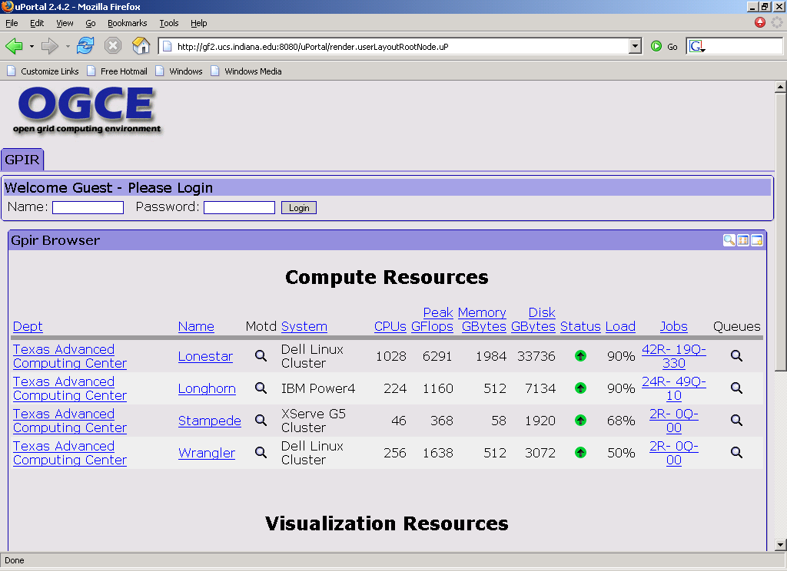

Slide 13
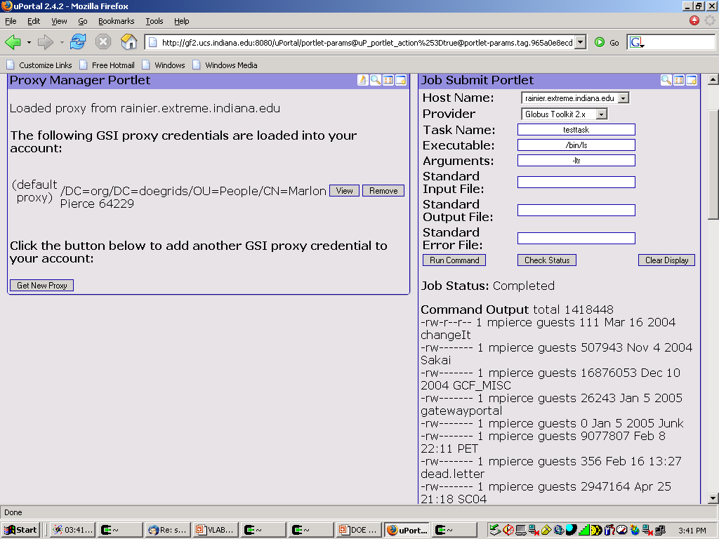

Slide 14
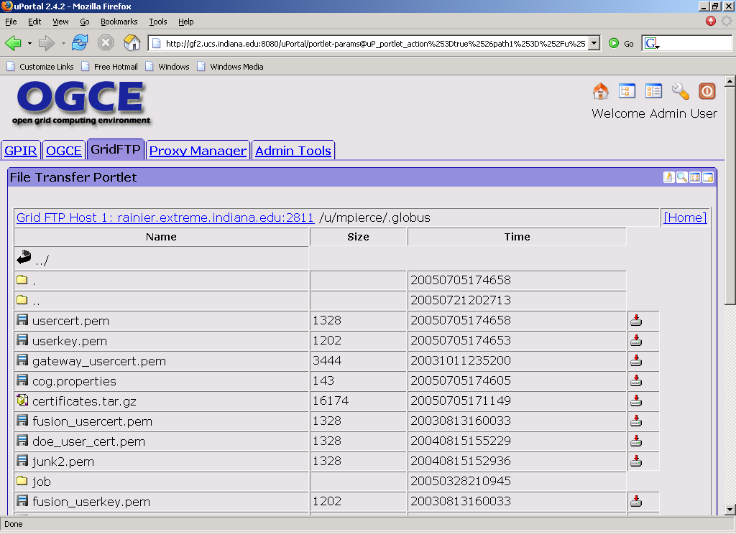

Slide 15
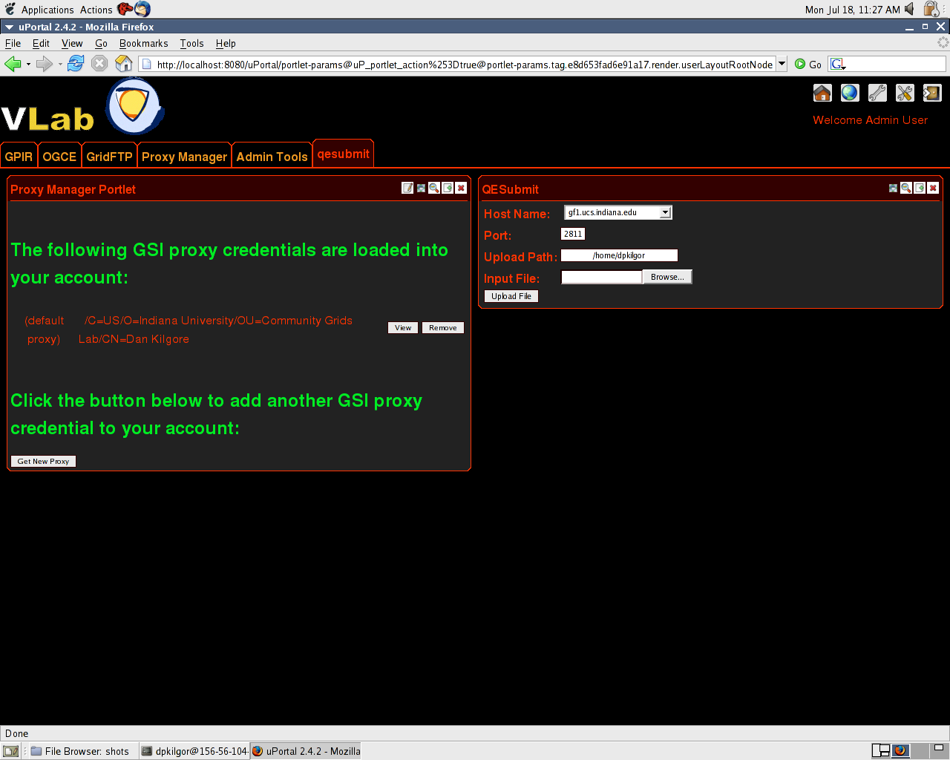
VLAB Portal Status
Adapting pre-existing OGCE Portal tools.
Quantum Espresso codes installed on test bed at IU.
Simple Globus submission for PwSCF.
File uploading from desktop.
Simple monitoring and downloading.
Hard part is always developing useful user interfaces to specific applications.

Slide 16
Backup slides

Slide 17
Grid Portal Development
Hard part is developing a nice, intuitive, simple, yet complete and useful user interfaces for specific applications.
Requires “domain expertise” (i.e. knowledge of how to set up and run the quantum chemistry codes in meaningful ways)…
…combined with Web design expertise…
…combined with Java programming experience.

Slide 18
Soon To Be Solved Problems
How to get non-VLAB portlets and VLAB portlets integrated.
Sakai project is a learning management system that provides
Personal and group-sharable calendars, document sharing tools, discussion group tools, etc.
These should be available soon in uPortal and GridSphere portal containers.

Slide 19
Grid Portal Solved Problems
Logging securely into remote machines and running jobs as yourself.
Uploading, downloading, and cross-loading files between your desktop and various remote resources.
Layout management.
User customization/personalization
Storing and retrieving persistent information.
Monitoring jobs (eh…)

Slide 20
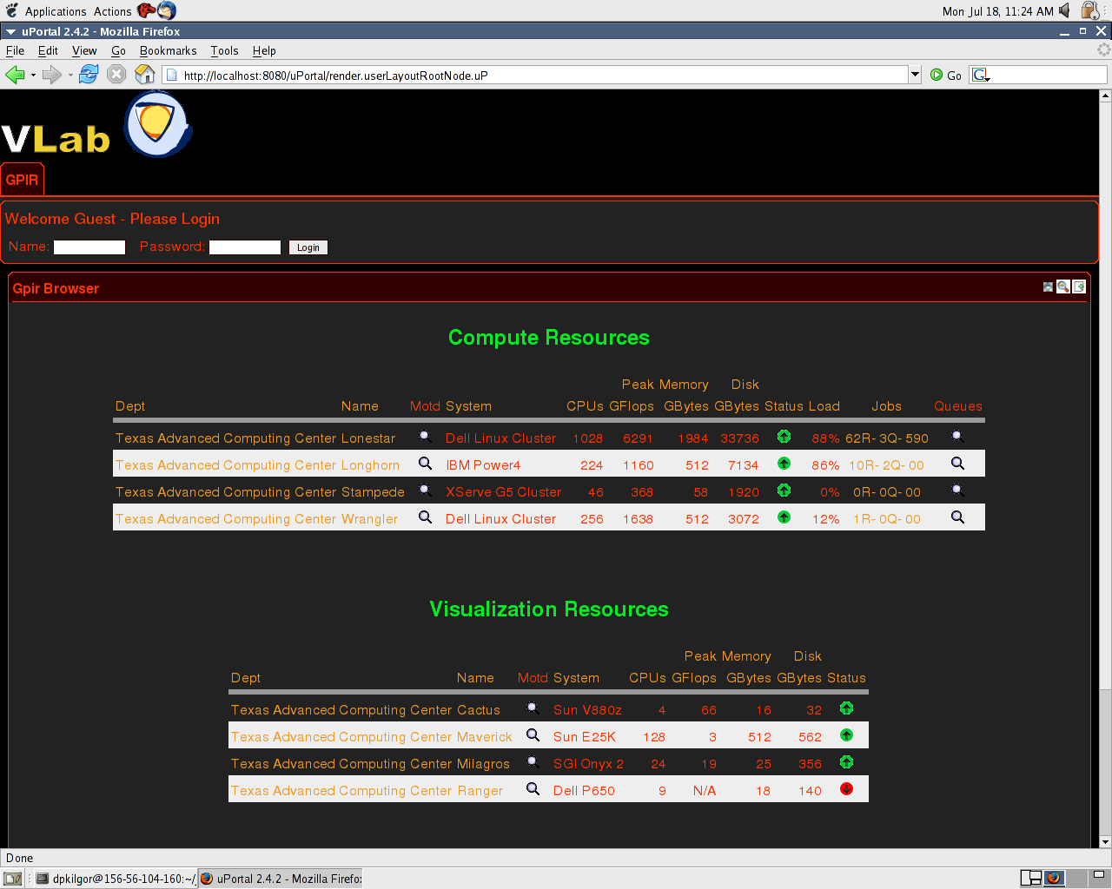

Slide 21
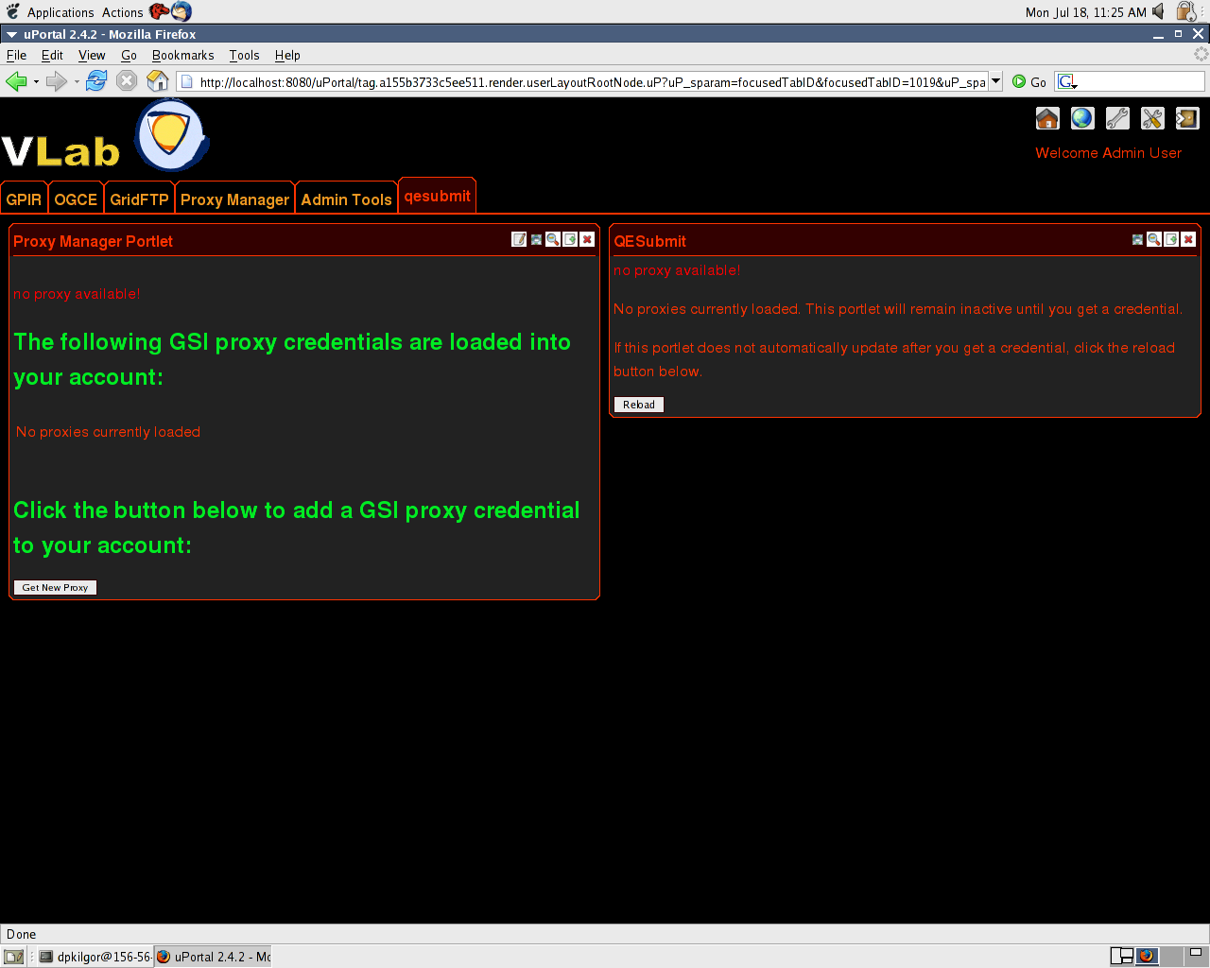

Slide 22
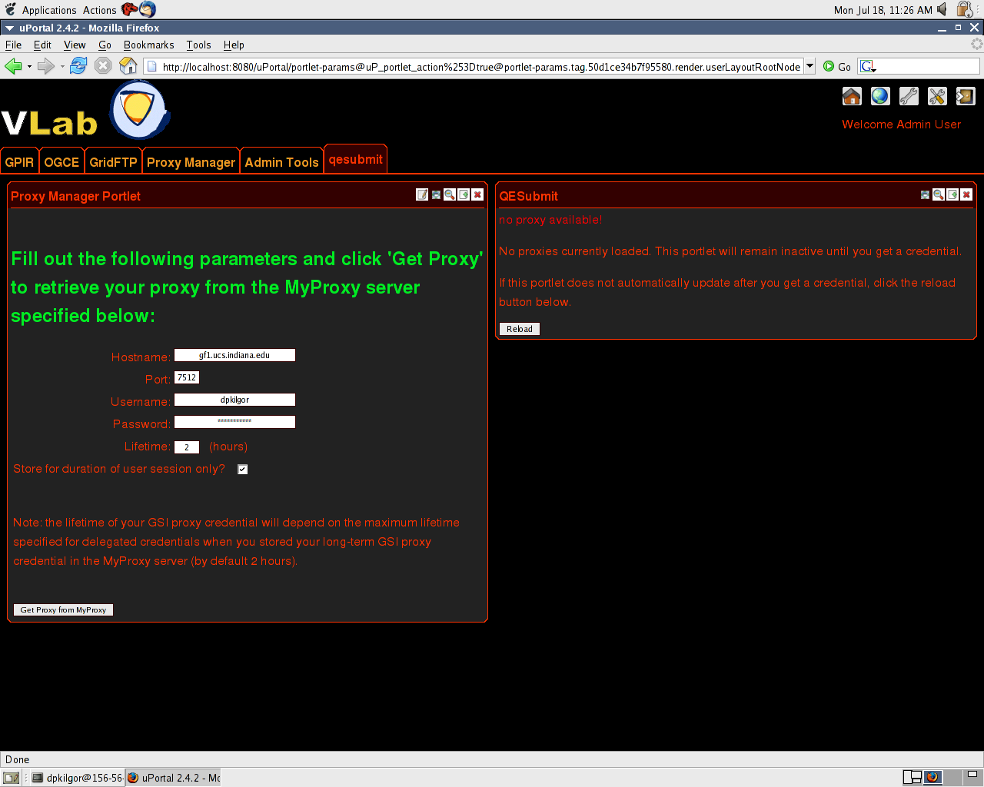

Slide 23
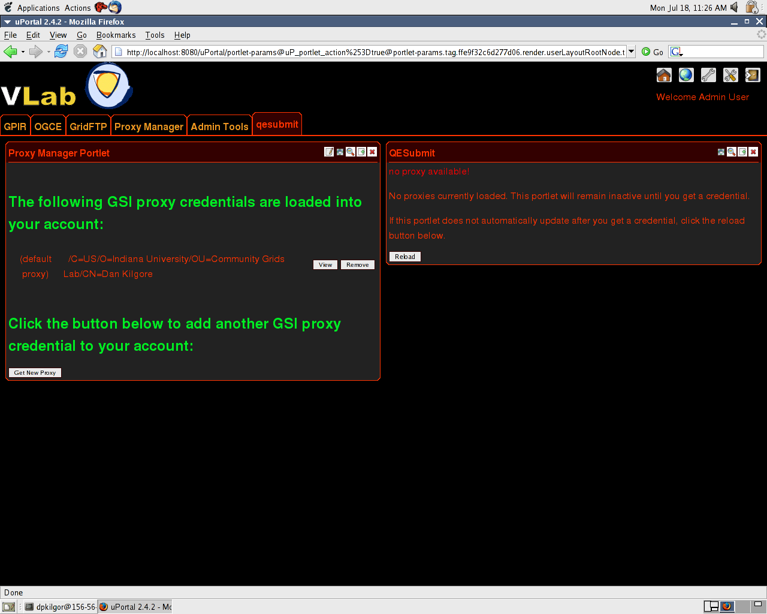

Slide 24
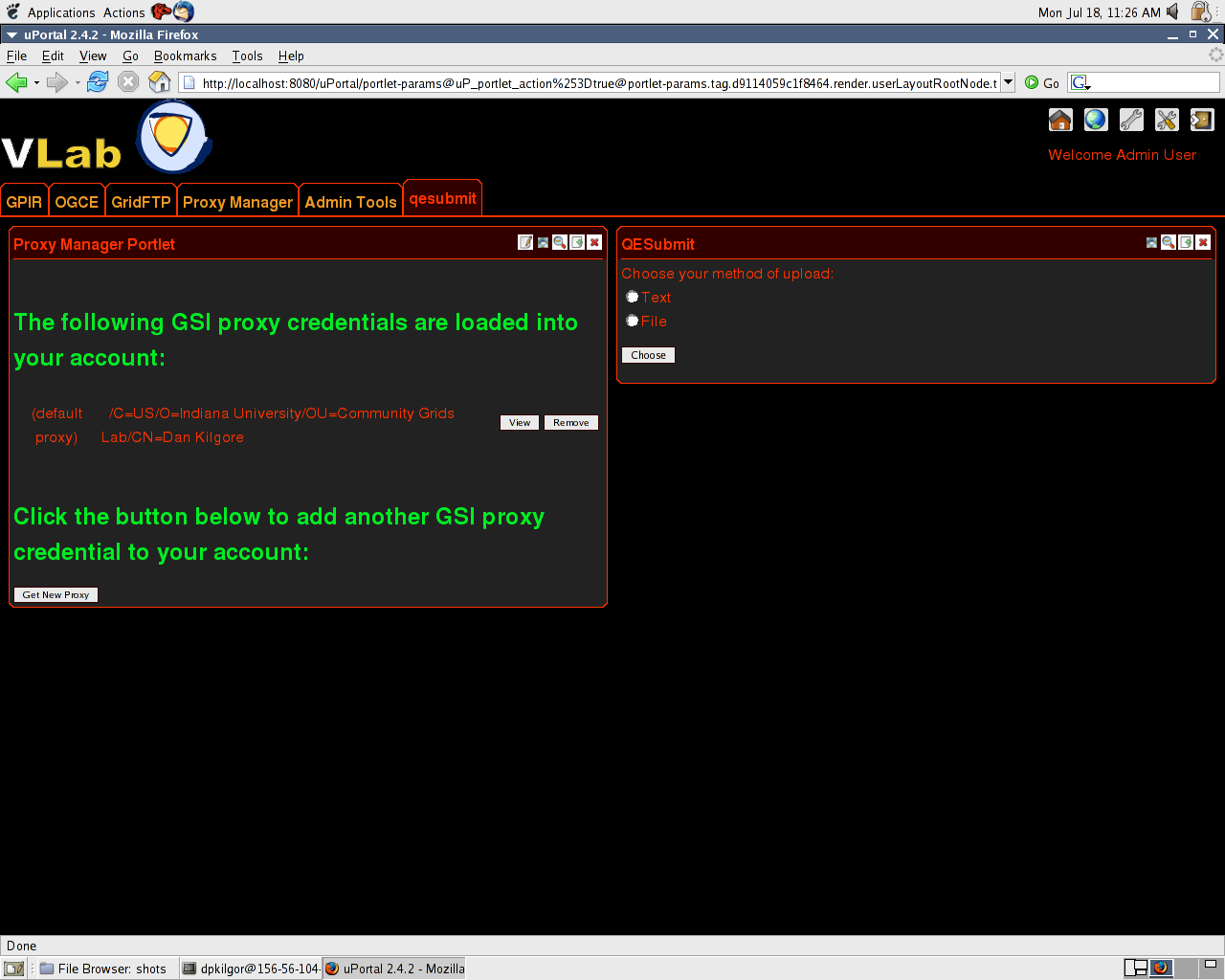

Slide 26
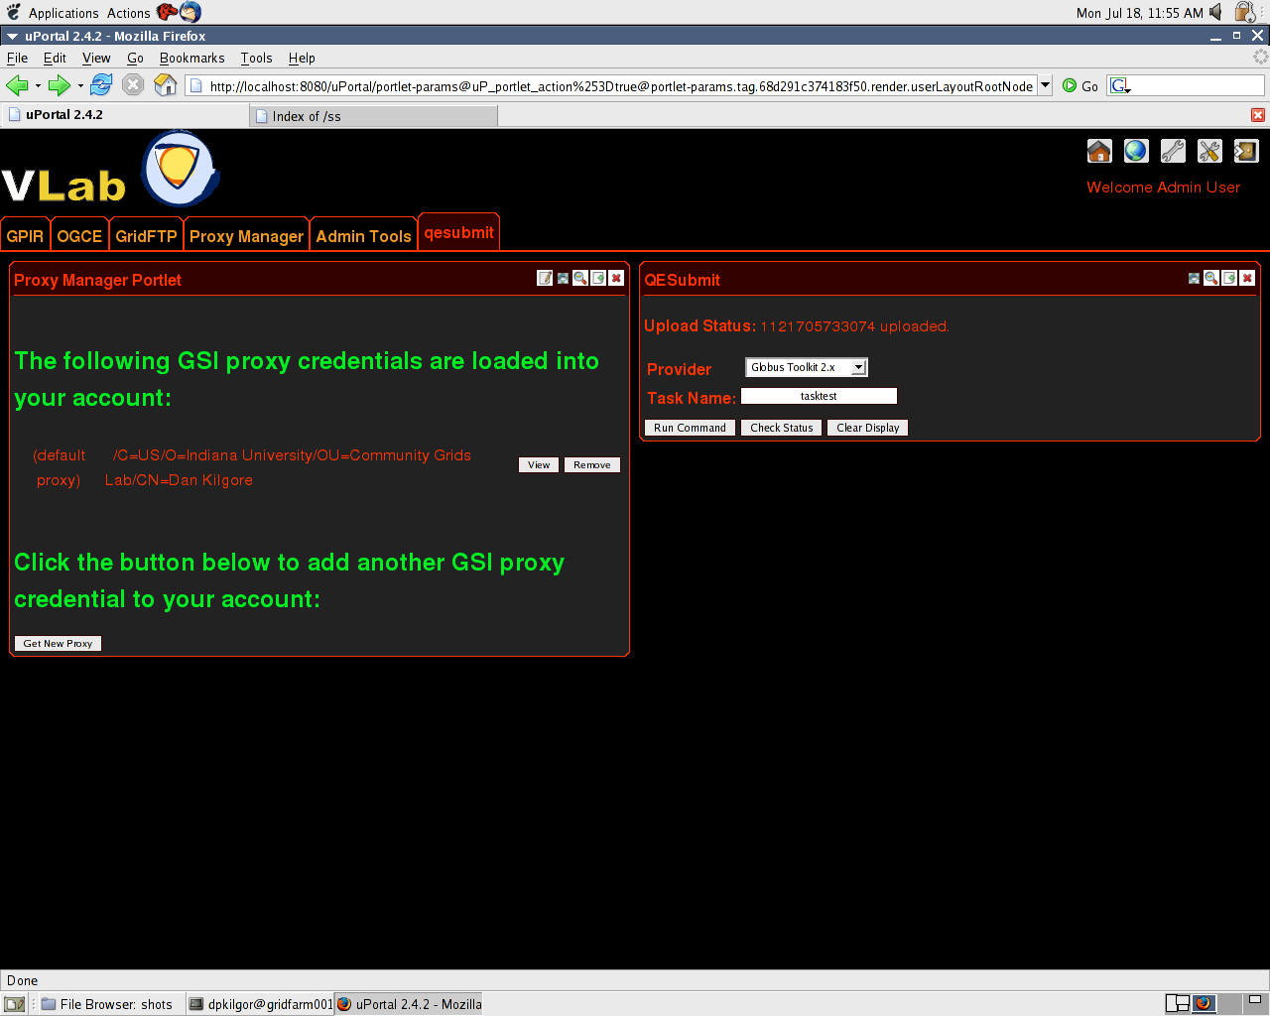

Slide 27
Main Globus Stuff
A single sign-on security system
Allows you to get a ticket and seamlessly log into all machines on your Grid with no future logins.
Known as GSI
Similar to Kerberos
GRAM and GridFTP use GSI for security
GRAM: an abstraction of a remote command operation.
GRAM “job specifications” can be used to run simple remote commands (like rm –r *.*)
Can also be used to submit jobs to queuing systems (PBS, LSF, Sun Grid Engine)
GridFTP and Reliable File Transfer
Can be used to move files around
Can also do third party transfer: from Machine A, tell Machine B to transfer file to Machine C.
There are command line tools for all of these things (included in the release).

Slide 28
Grid Non- and Open Problems
Not a replacement for MPI.
You still want to use this for parallel programming.
Grids are better for running and managing applications, moving data files around, etc.
No standard way of chain applications into distributed flow charts (workflow). There are several tools.
Triana
Pegasus
Karajan (part of the Java CoG Kit)
HPSearch can be used for this
Hiding resource locations
You still typically pick the place to run.
But Grid software gives you a starting point.

Slide 29
Grid Web Portals
Java is of course a popular tool for building web applications.
These can also talk to Web Services and NaradaBrokering on remote hosts.
The Java CoG allows you to make these web applications talk to Grid services.
So you can write Java web applications that can retrieve security credentials, launch remote jobs, and move files around.
Lots of people have done this…

